Slide 1
Determining Factors That Impact The Usage Of BikeShare In New York City
Ishin Yavuz, Shreyansh Saraiya,
David Park, Michael LaPiana

Slide 2
What did we look for?
With this dataset, we are aiming to look at if the bike share program is a necessity that can be implemented during different seasons. By analysing patterns of ridership usage, it allows us to interpret the data. Which, in return, suggests a better comprehension of the trends concerning the Bike Share program. We aim to look at factors such as trip start time, trip end time, trip duration, trip start station, trip end station, and user type.

Slide 3
Research Questions
How many individuals use the bikeshare program?
Rider’s age + gender (Ride Count by Birth Year + gender)
In which season is the bike share usage most popular?
January - September 2020
What is the peak time of use during a day for Bikeshare?
What percentage of the Bikeshare users are members vs. public users?
Trip Duration by User Type
What is the most popular station?
Top 5 stations with the most starts (showing # of starts)) / most popular trips

Slide 4
Where we got the data?
We were able to find monthly data sets from Citi Bike in New York City that included start and stop time, start and end station name, start and end station longitude and latitude and the bike id. It also included user data such as birth year, gender, and whether or not they were subscribers.

Slide 5
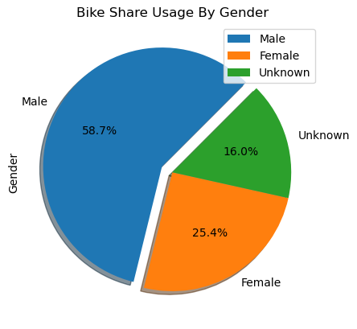
How many people use BikeShare in NYC & what are their demographics?

Slide 6
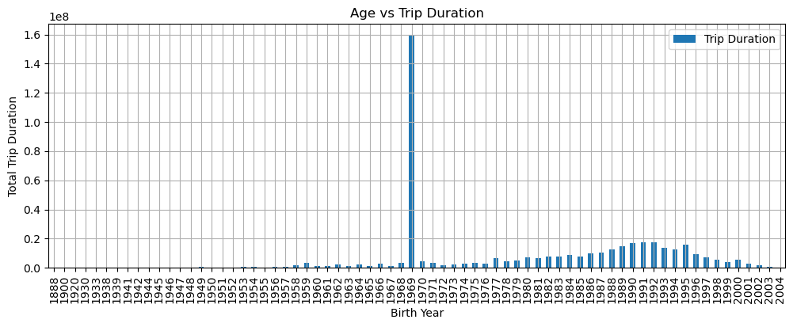

Slide 7
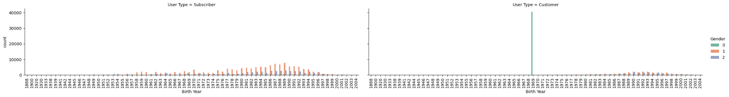

Slide 8
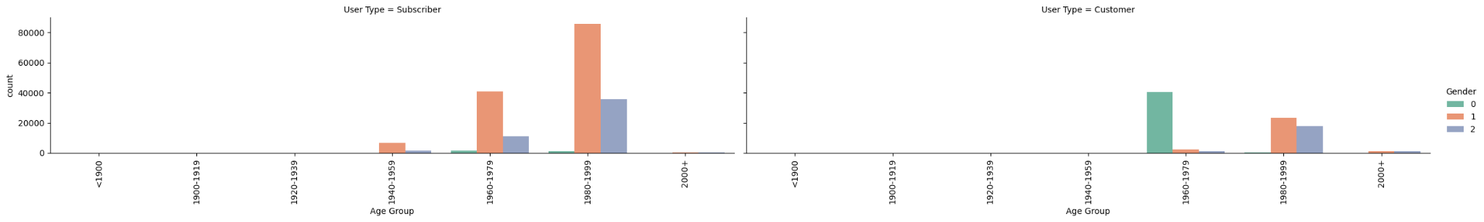

Slide 10
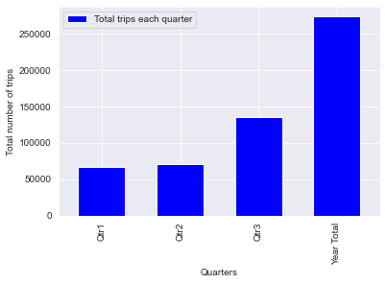

Slide 11
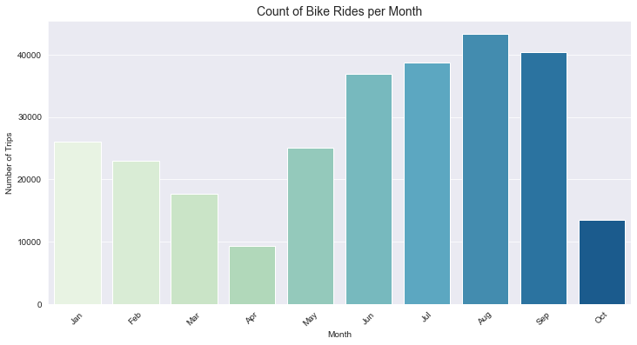
In which season is the bike share usage most popular?

Slide 12
What is the peak time of use during a day for Bikeshare?
For this question we were able to determine the peak time of the day for three different three month long segments.
Quarter One - January - March
Quarter Two - April - July
Quarter Three - August - October

Slide 13
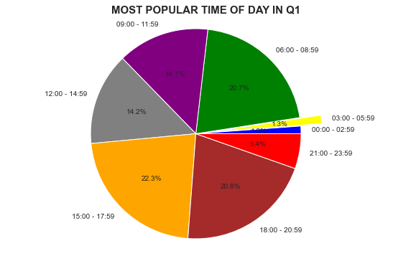

Slide 14
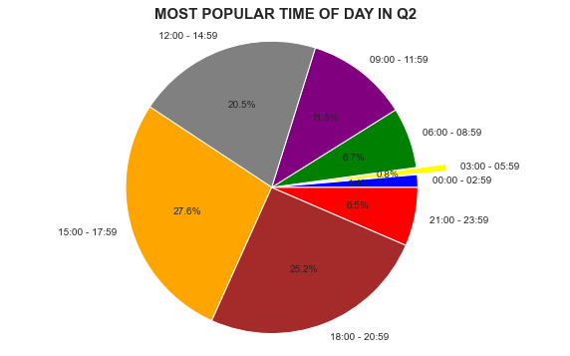

Slide 15
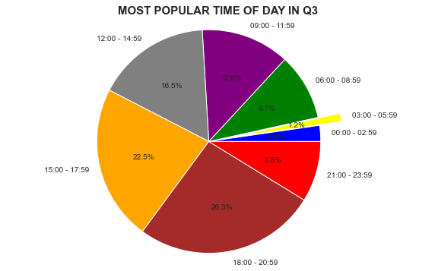

Slide 16
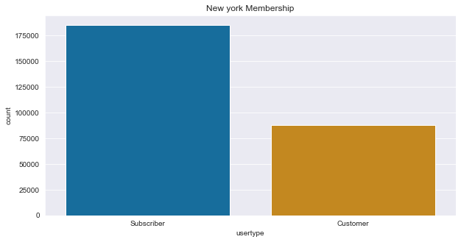
What percentage of the Bikeshare users are members vs. public users, and which type of user takes longer trips?

Slide 17
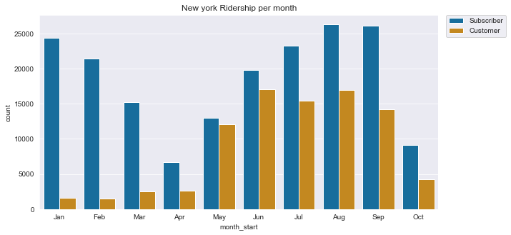
(cont.) members vs. public users

Slide 18
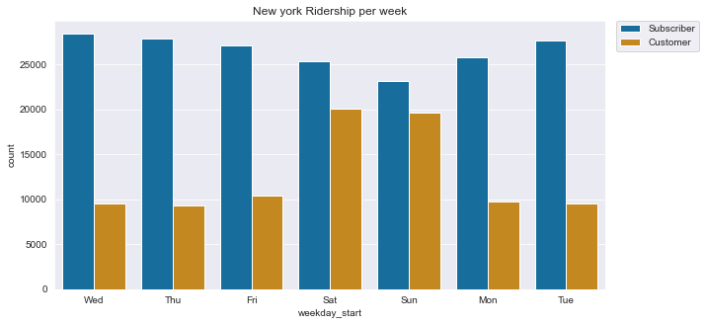
(cont.) members vs. public users

Slide 19
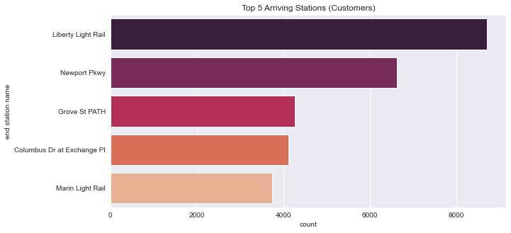
What is the most popular station & does customer type affect it?

Slide 20
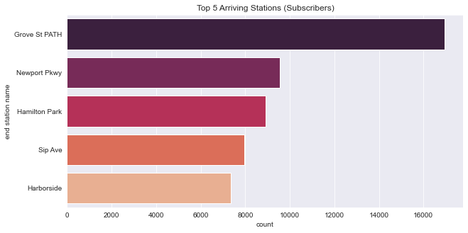
(cont.) most popular station

Slide 21
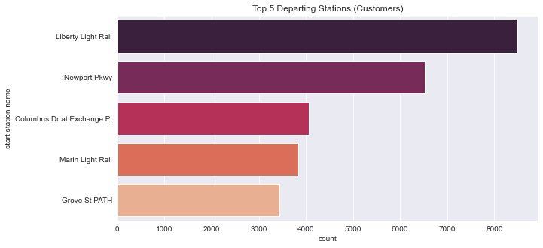
(cont.) most popular station

Slide 22
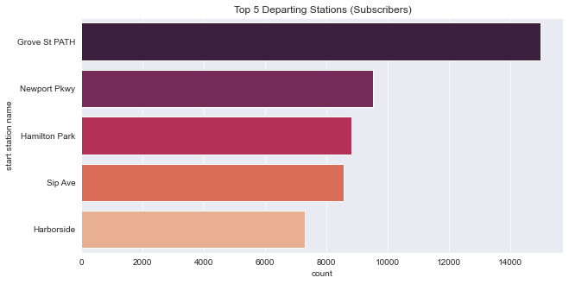
(cont.) most popular station

Slide 23
